Slide 1



Slide 2

Disadvantaged Business Enterprise
Goal Setting Tutorial

Slide 3
The Tennessee Department of Transportation has developed this goal setting tutorial in order to help you better understand the steps involved in maximizing DBE participation on Goal contracts.
This presentation will expand on the steps given in the document that can be downloaded from TDOT’s Civil Rights website at:
www.tn.gov/assets/entities/tdot/attachments/GOALTutorialWorksheet.doc

Slide 4

It may be helpful to have the original document in front of you to refer to, as we will be touching on each item listed

Slide 5
When setting a DBE goal on construction projects, the following steps can be utilized:
Utilize staff with construction background to set DBE goals.
Using members from your office with knowledge of the construction industry is an obvious first step to successful goal setting.

Slide 6
2) Review projects based on the following criteria:
Federal funding allocation (approximately $500,000 and above)
Work Items (types & estimated costs per unit)
Availability of DBEs to perform work
Work item types would include such items as clearing and grubbing, concrete flatwork , erosion control, etc.
Costs per unit are determined by the amount allocated for the specific work type at hand.
The Availability of DBEs to perform work may be obtained through TDOT’s DBE Directory found at:
www.tdot.tn.gov/APPLICATIONS/DBEDirect

Slide 7
3) Create a DBE goal-setting worksheet that includes all work items that a DBE could perform
An example may be downloaded from TDOT’s website, and can also be seen on the next slide.
This example worksheet may be modified to fit your individual needs.

Slide 8
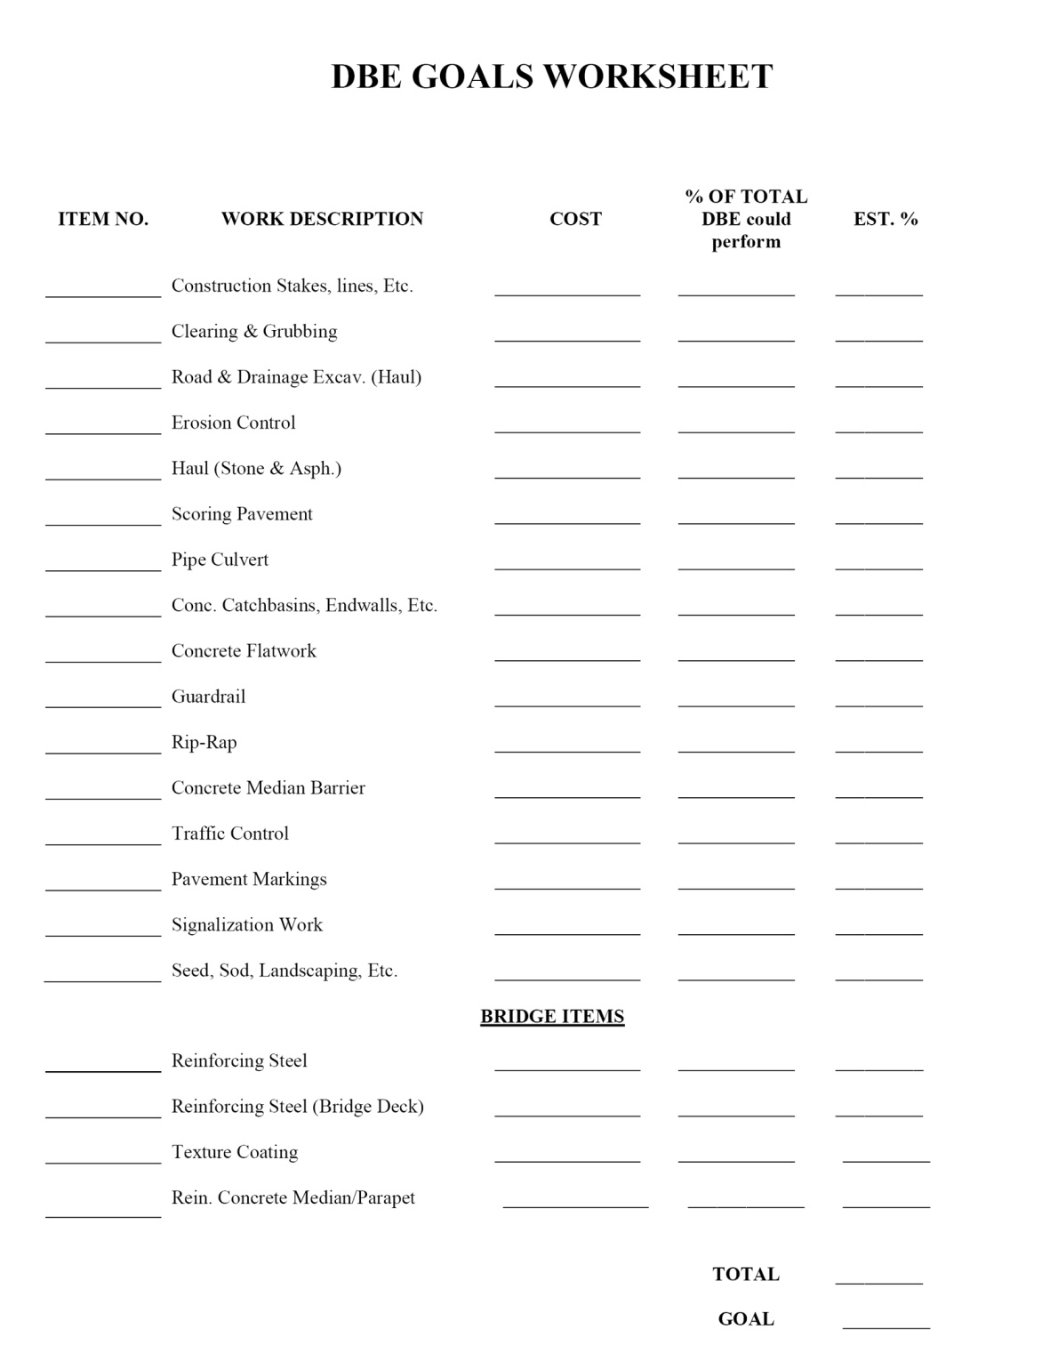

Slide 9
4) Determine each work item for the project at hand and review any available information concerning DBEs who have performed similar work in the project’s geographical area. It may be helpful to write the names of these DBEs on the goal-setting worksheet, as seen on the next slide.

Slide 10
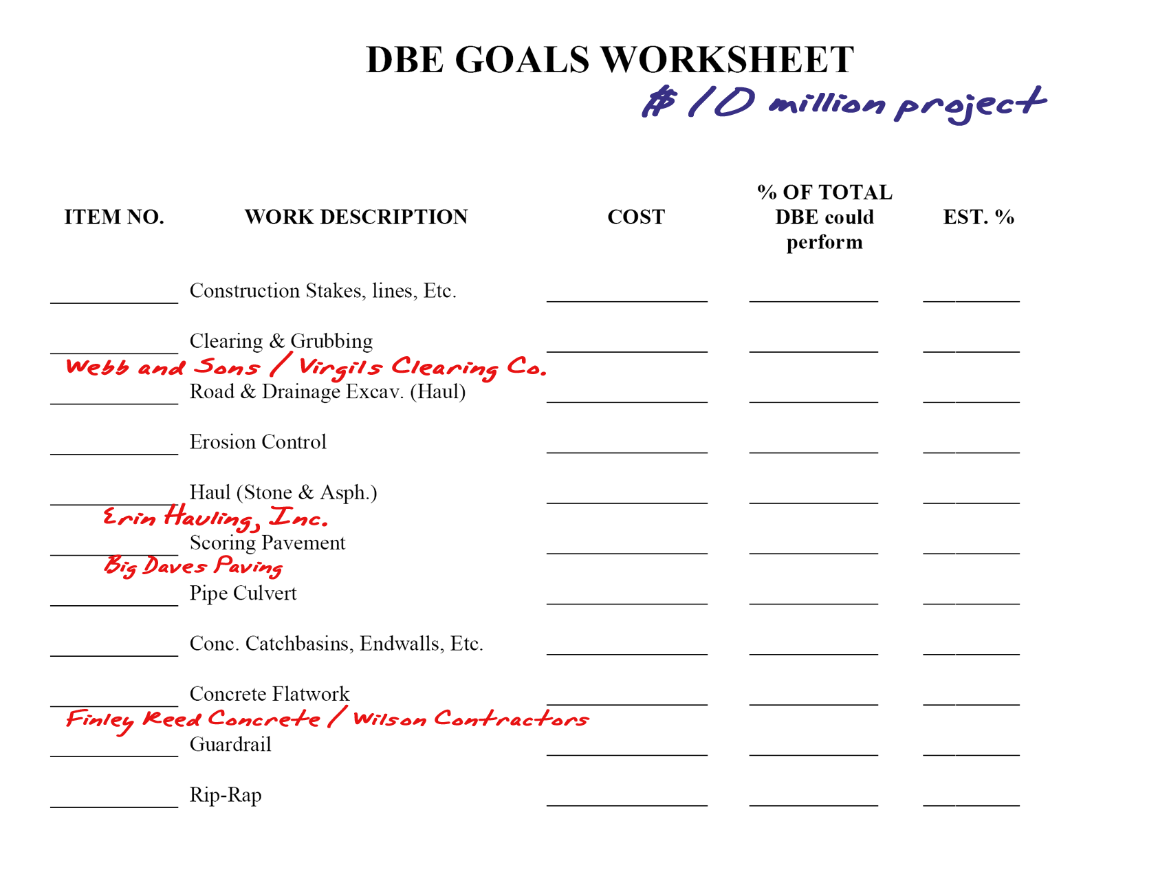

Slide 11
5) Fill in the individual work items that have the potential of being subcontracted to DBEs. Insert the cost for each item in the COST column of the worksheet. The % OF TOTAL can then be completed by dividing the cost of the work item by the overall project cost.
The percent of total will be a decimal and must be converted by moving the decimal point to the right two places.
In our example $10 million contract , there is a $100,000 cost for clearing and grubbing. Divide this work item amount ($100,000) by the total project cost ($10 million) and the total available will be .01 … or 1% after it has been converted. Complete for all applicable work items.

Slide 12
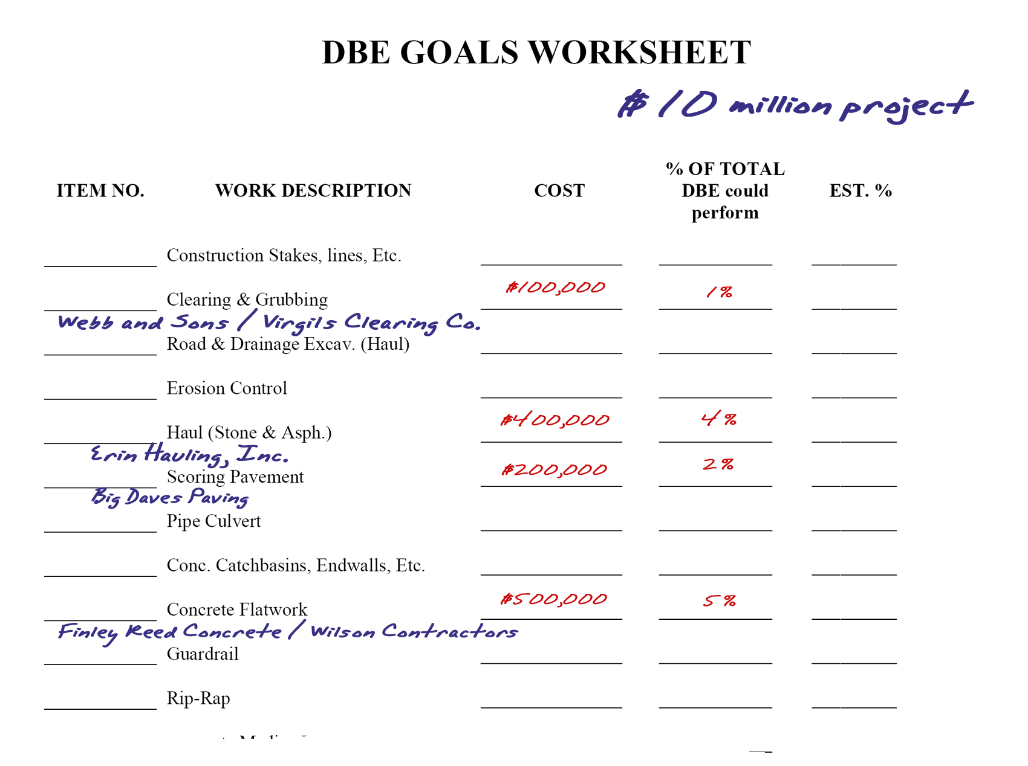

Slide 13
6) Adjust the % of Total amounts (if necessary) to find a figure that would be more realistically attained through subcontracting. This would be the Estimated Percentage and can be added to the worksheet in the EST % field.
To keep all the numbers in the % of Total field as they are would require Prime Contractors to subcontract 100 % of all of the work items that could be subcontracted to a DBE. These numbers are generally reduced to find a compromise between finding and using DBEs without causing undue hardship on the Primes.

Slide 14
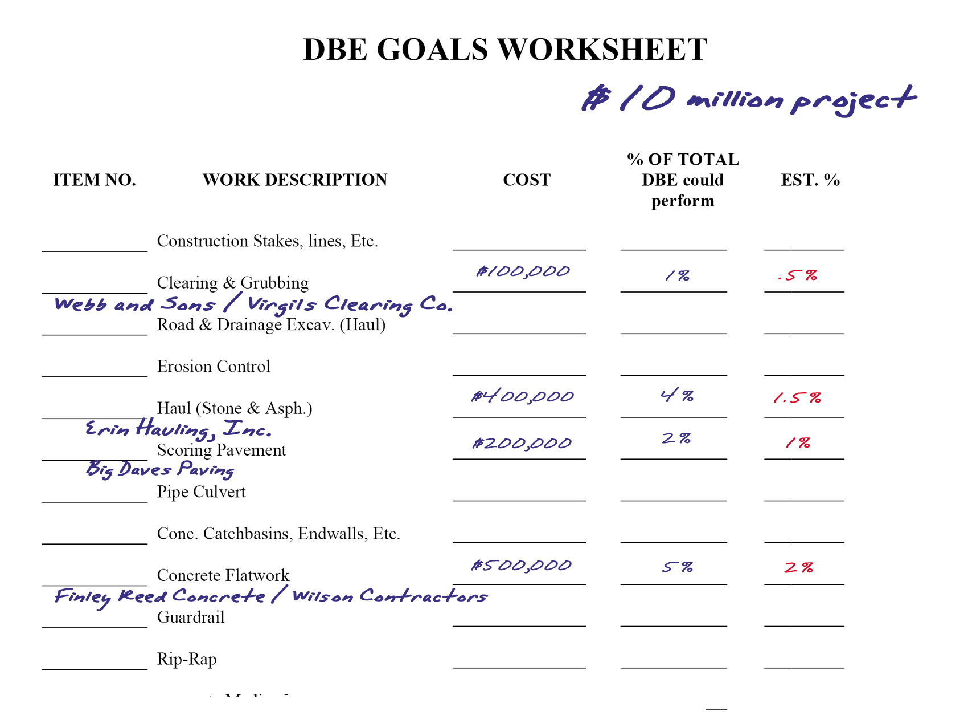

Slide 15
7) Total all individual work item percentages (EST % column) which may be used for goal work (this figure will go in the TOTAL field at bottom of form). Review the total percentage to determine if further adjustments may be necessary. The adjusted figure is your GOAL.
This number may need to be further reduced if it exceeds a realistically obtainable figure. Again, note that to keep the current figure would mean that the Prime Contractor would be responsible for subcontracting every work item to a DBE. This may not be possible as capable DBEs may be unwilling to bid on the job, may be too busy to bid on the jobs, etc. There needs to be some flexibility in the final number to accommodate these situations.

Slide 16
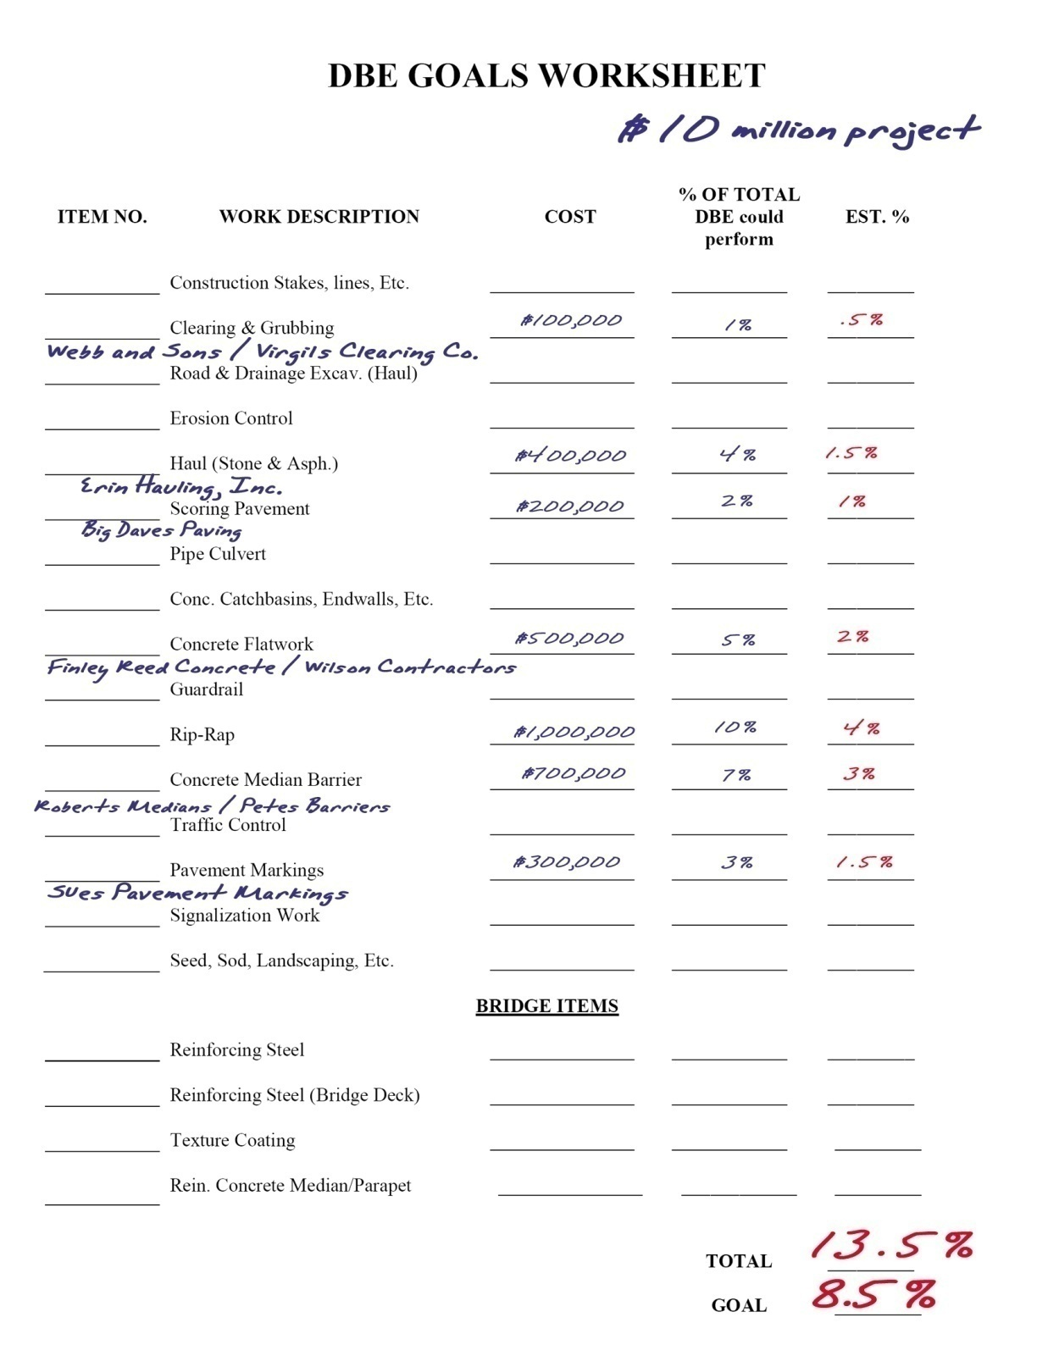

Slide 17
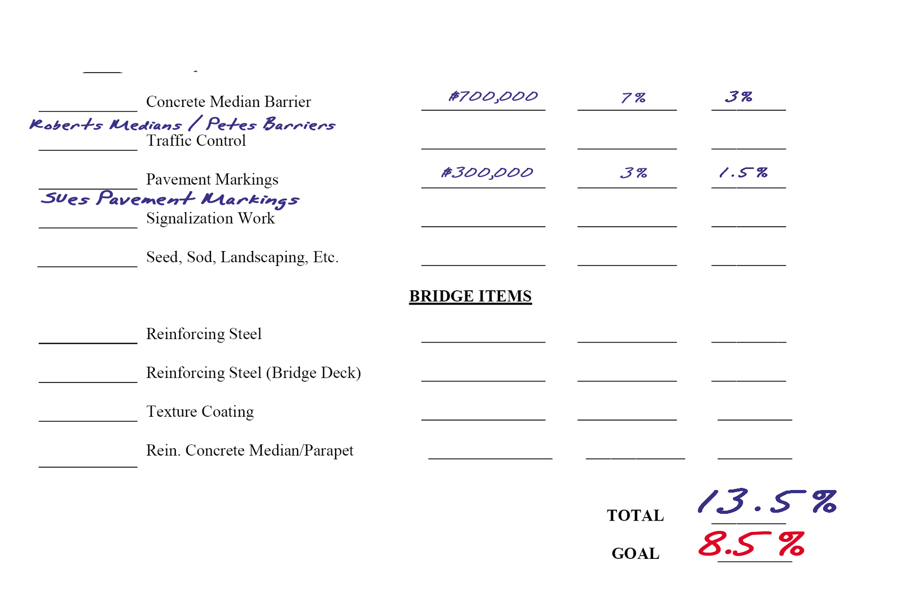
The sample 13.5% goal was further reduced for a total goal of 8.5%. Goal setting is now complete for this contract and the steps would then be repeated for any subsequent contracts.

Slide 18
For more information concerning TDOT’s DBE program, please visit the website at:
www.tn.gov/tdot/topic/small-business

Slide 19
Thank you

