Slide 1
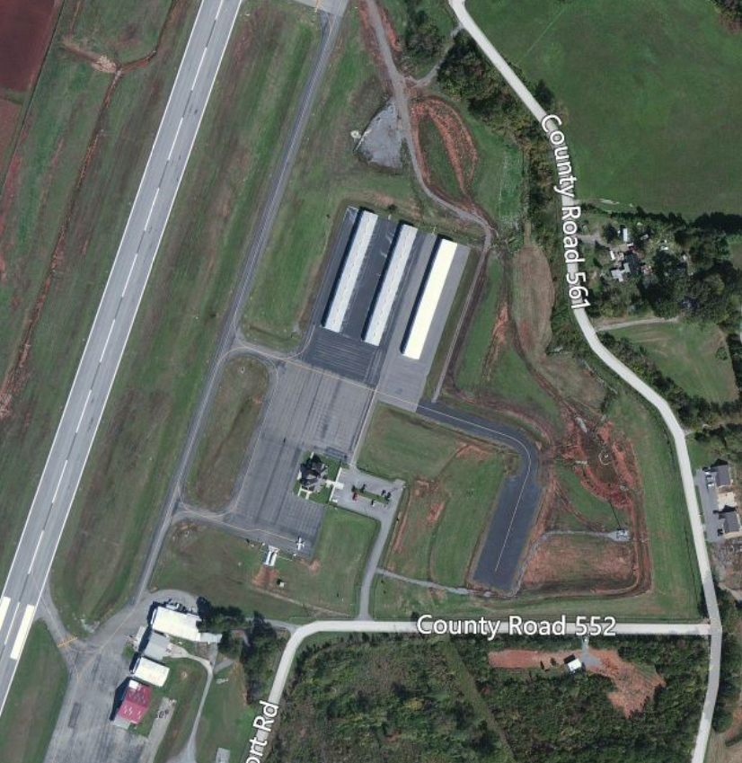
AIRPORT NAME
PRESENTOR’S NAME
Airport Logo Here
Notes:
This is the TITLE SLIDE
This slide is used as an identifier and should be the first slide for every project you submit
Use whatever picture you feel identifies your airport
Once you set up this slide, it should be identical with every project you submit
If you would like, TDOT will provide an aerial photo of your airport
Include your airport’s logo at the bottom right corner
This logo will be used throughout the slides
Please use the same logo for each page

Slide 2
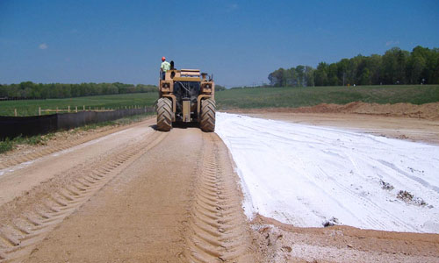
Project Title
Airport Logo Here
Notes:
This is the PROJECT TITLE slide
Please replace the words “Project Title” with the title of your project
Find a picture representation of your project and place it here
The airport’s logo should be in the top right corner of this slide

Slide 3
Project Summary
Airport Logo Here
Why is the project needed?
Do not leave the questions in your presentations.
Use the bullet points provided in this format as needed.
What will the project consist of?
Where on the airport does the project take place?
When will the project be completed?
If amendment explain why additional funds/scope of service are changing.
Notes:
This is the PROJECT SUMMARY SLIDE
Please answer the questions listed here for every project you submit
Be clear and concise
Use the bullet points as seen in this template
The airport’s logo should be in the top right corner of this slide

Slide 4
Financial Breakdown
Airport Logo Here
Federal Funds (90%): $13,000.00
State Funds (5%): $4,000.00
Local Funds (5%): $4,000.00
___________________________________________ Total (100%): $21,000.00
Notes:
This is the FINANCIAL BREAKDOWN slide
The cost should be divided into Federal, State, and Local funding
A percentage of each type of funding should be included
The airport’s logo should be in the top right corner of this slide
This should always be the last slide of your project’s presentation

